Slide 1
Machine Learning as a Service
By
Megha Singh and
Sneha Malshetti

Slide 2
The different MLaaS
AmazonML: Amazon Machine Learning: use cases and a real example
AzureML: Azure Machine Learning: simplified predictive analytics
BigML: BigML: Machine Learning made easy
Datoin: Build Intelligent Apps.
Ersatz: Hosted deep learning with GPUs
ForecastThis: automated predictive modeling solutions
Google Prediction API: Google Prediction API: a Machine Learning black box for devs
MLJAR: Platform for building Machine Learning models
Natero: Customer Success platform that predicts churn and up-sell opportunities
DataRobot: Machine Learning Software - DataRobot
Vize AI: Custom image recognition API
Watson Analytics: Guided and automated analytics from the cloud.
Wise: Machine Learning for Customer Success

Slide 3
The MLaaS for Demo
AmazonML: Amazon Machine Learning: use cases and a real example
AzureML: Azure Machine Learning: simplified predictive analytics
BigML: BigML: Machine Learning made easy
Watson Analytics: Guided and automated analytics from the cloud.
H2o: A library to run different Machine Learning algorithms on IPython and R

Slide 4
What is Machine learning?
Machine learning is a data science technique that allows computers to use existing data to forecast future behaviors, outcomes, and trends. Using machine learning, computers learn without being explicitly programmed.
Applications of Machine Learning:
Forecasts or predictions from machine learning can make apps and devices smarter.
When you shop online, machine learning helps recommend other products you might like based on what you've purchased (Collaborative Filtering ).
When your credit card is swiped, machine learning compares the transaction to a database of transactions and helps detect fraud.
When your robot vacuum cleaner vacuums a room, machine learning helps it decide whether the job is done.

Slide 5
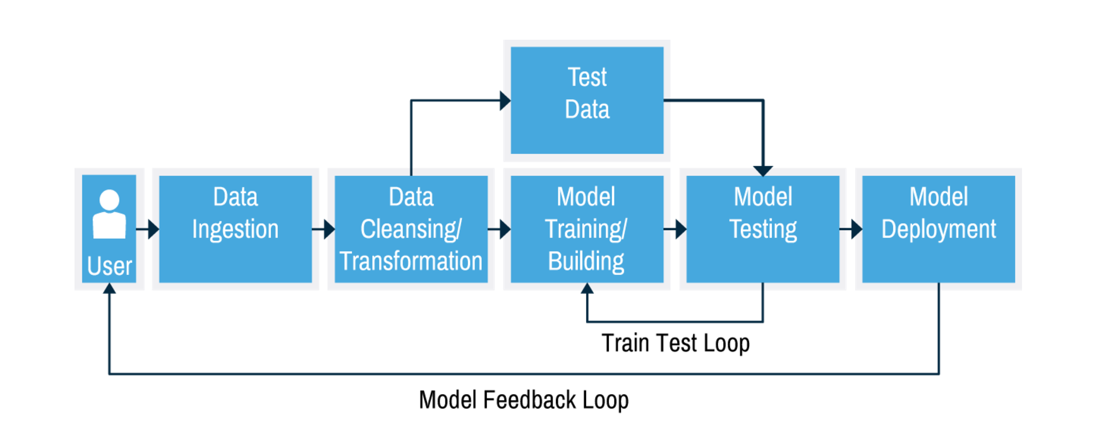
Work flow of Machine learning model

Slide 6
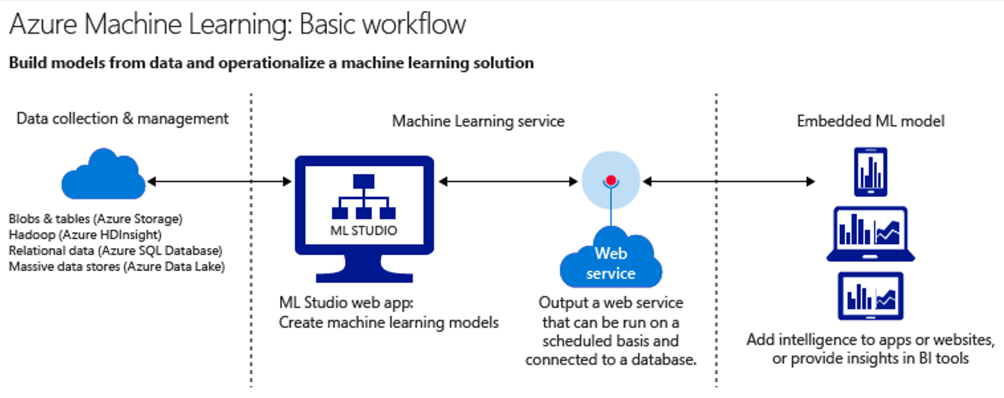
Microsoft Azure
Architecture

Slide 7
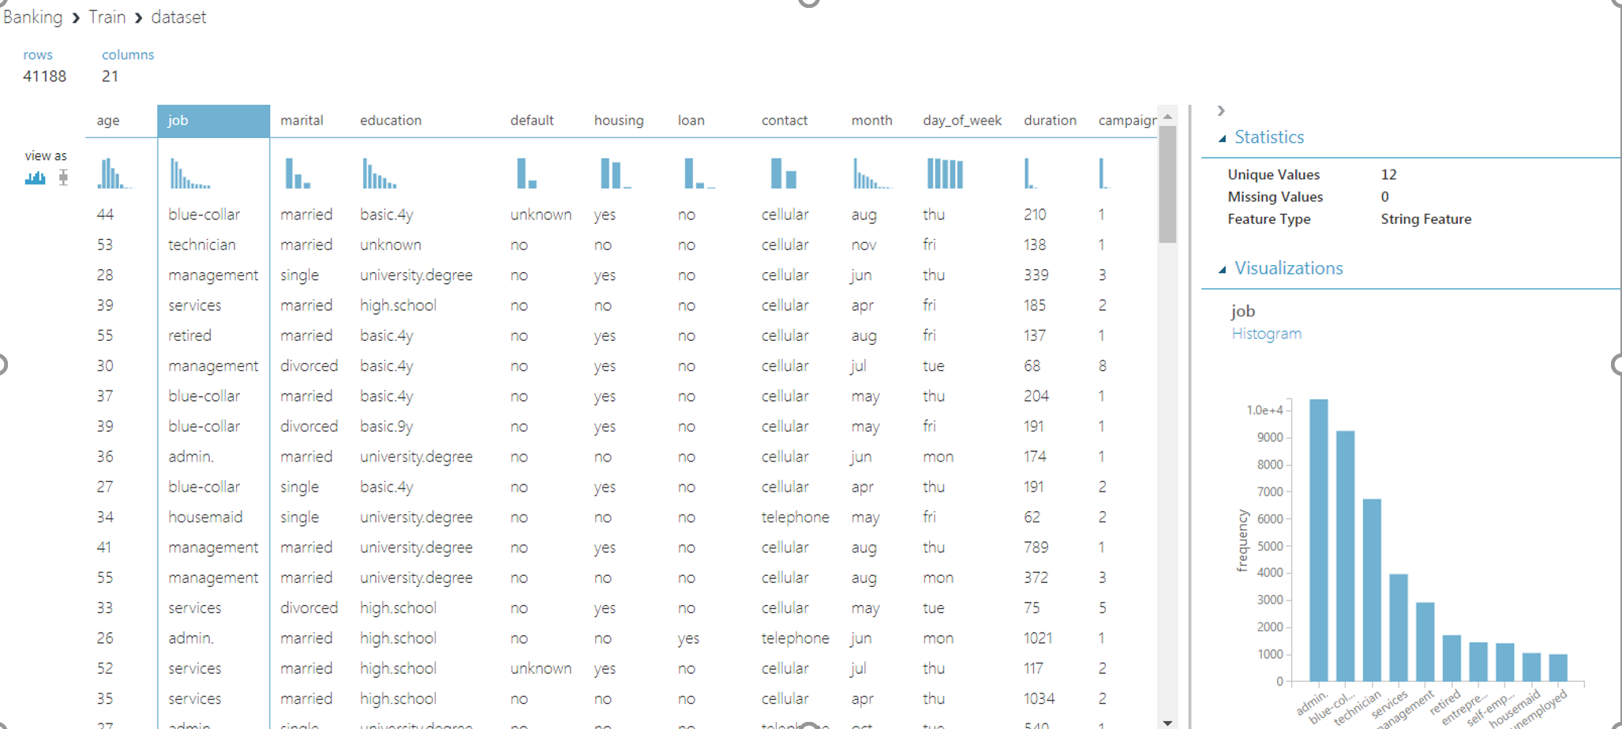
The schema of the dataset in azure comes with plots and individual column statistics and visualizations as hown below

Slide 8
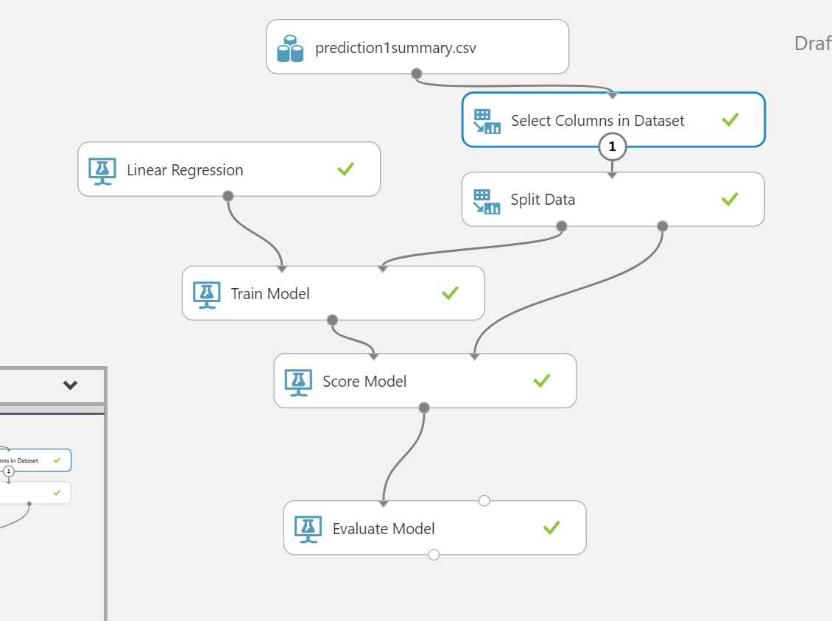
A model in Azure looks as follows:
The model has a dataset at the top.
Column selction is done on the dataset
The data is then split into 2 parts for training and testing the model
The model is scored
The model is then evaluated and we get the visualized evaluation at the end node

Slide 9
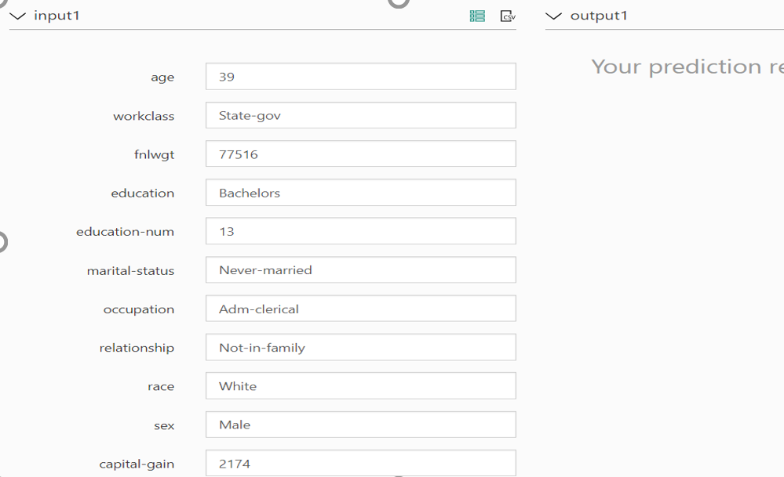
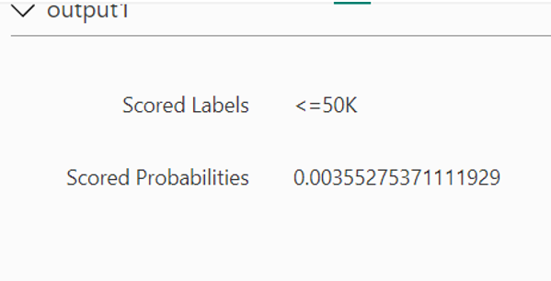
On the left is the input entered
manually or by default
On the right is the corresponding output:
The scored labels column or value gives
you the predicted value and the Scored
Probabilities gives you the probility

Slide 10
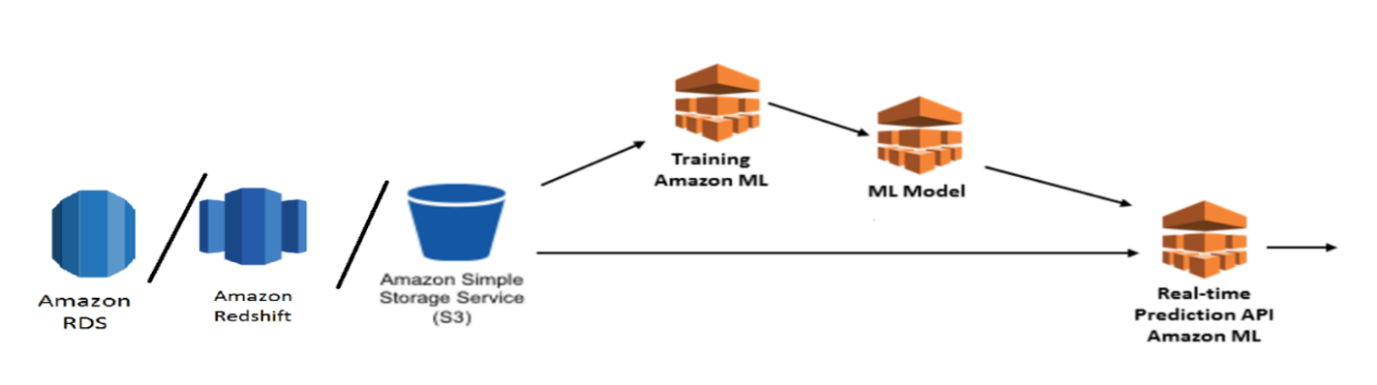
Amazon ML as Service
Architecture:
The diagram here represents the architecture of the AmazonML service
It shows the storage, Model and Prediction details

Slide 11
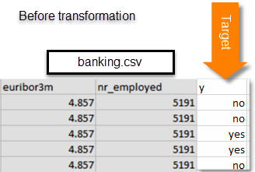
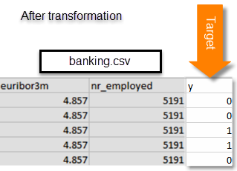
Data Preparation :
The y column which is the target column has yes and no as its data values, which we reploce with 1 and 0 in data preparation

Slide 12
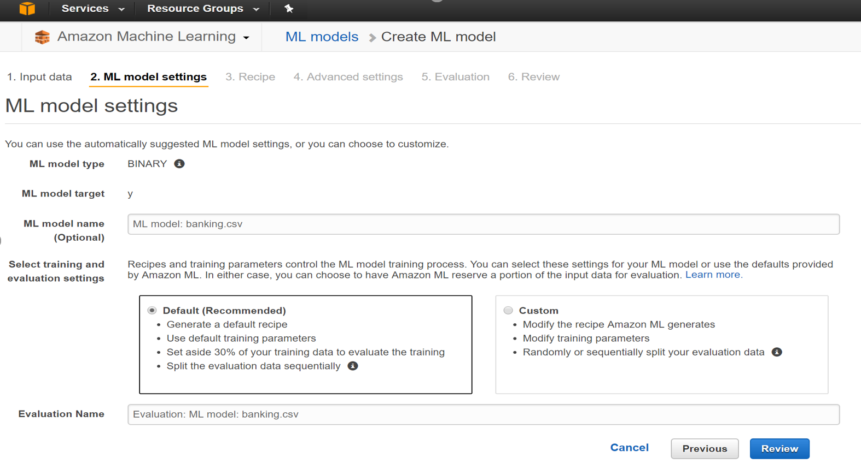
The dataset should be selected
The Target column should be selted and
The model to perform regression should be selected
The Default recipe here is that the data will be divided into 70 and 30 percent for training and testing respectively.
The custom reciepe however allows you to select customized ratios

Slide 13
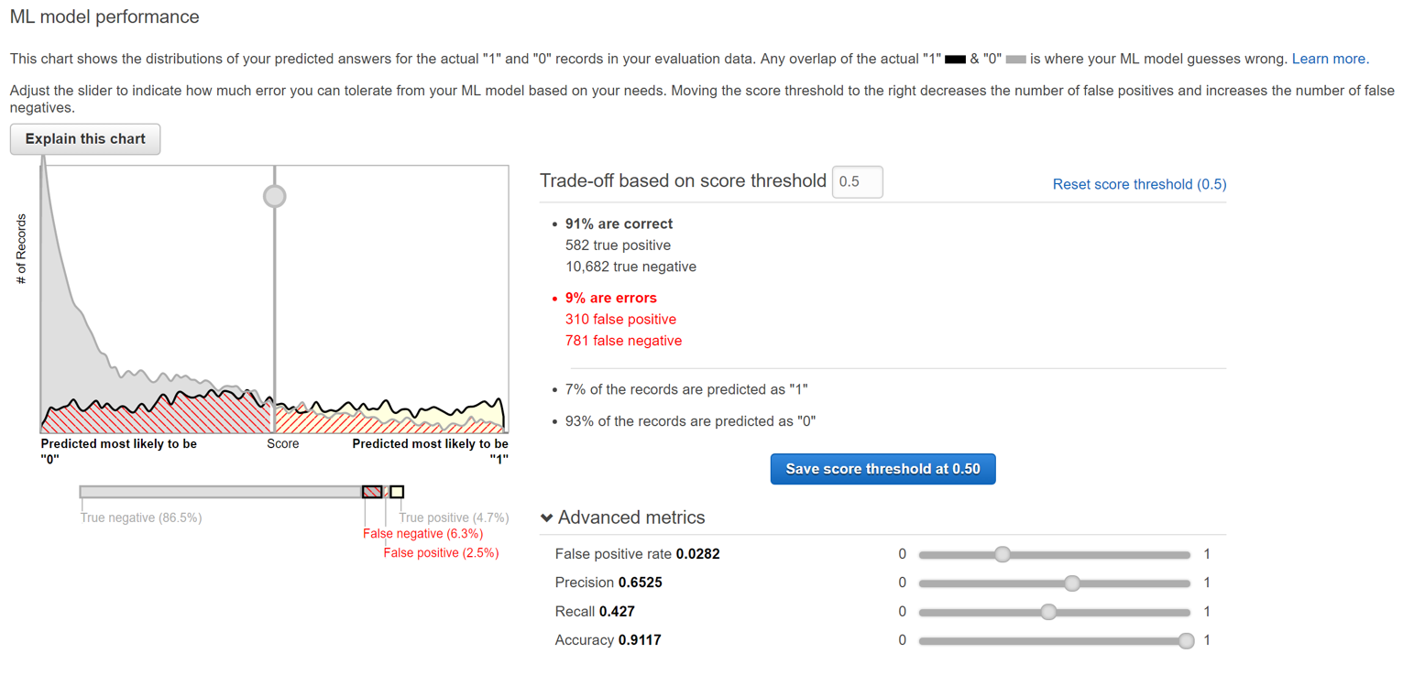
The Model once prepared and evaluated looks as shown
The graph shows the true positives and the true negatives and the false positives and the false negatives.
The slider on the graph can be moved to change the values
Once the threshold is adjusted we need to save the model for further predictions

Slide 14
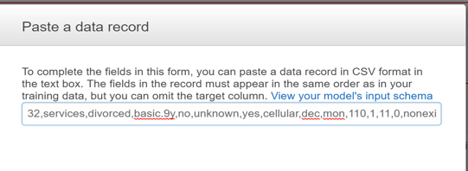
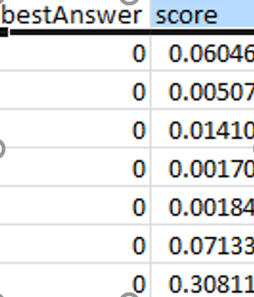
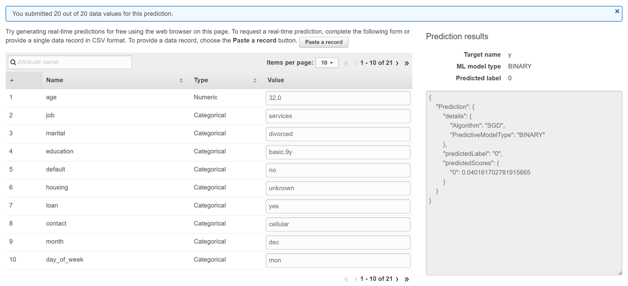
Perdition and model Analysis
The data can be manually entered or a row of the data from the csv can be entered directly.
The predicted score and label is
given in the form of json to use with
rest api
Also the algorithm used and the
Predictive model type is given
Based on the type of target
column, an appropriate algorithm
is picked by the service.
For batch prediction, we need to
Use a dataset from s3 and the
result also will be in a form of a
Dataset with only 2 columns, viz.
best Answer and score

Slide 15
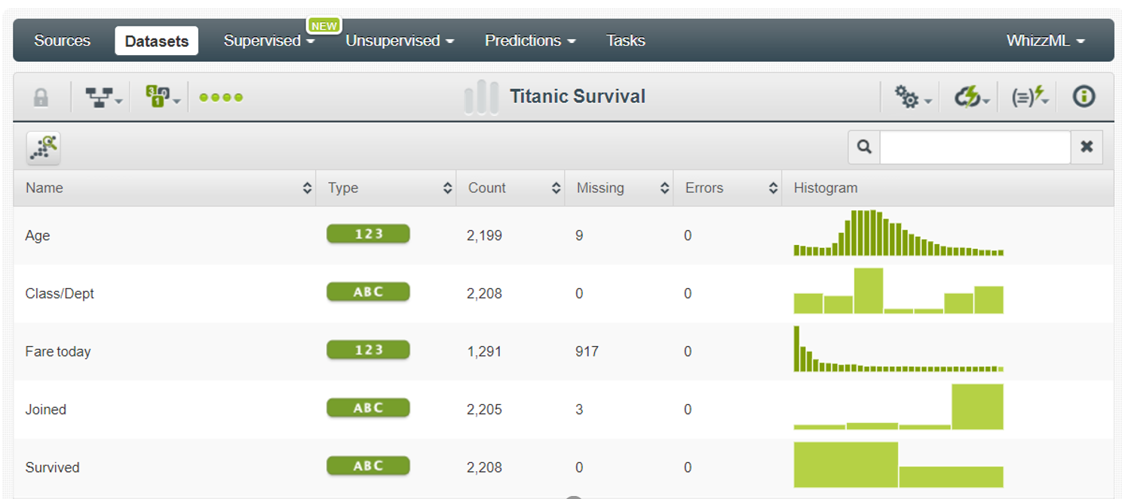
BIG ML as service
The data comes into the system and application let’s us analyze it as follows:

Slide 16
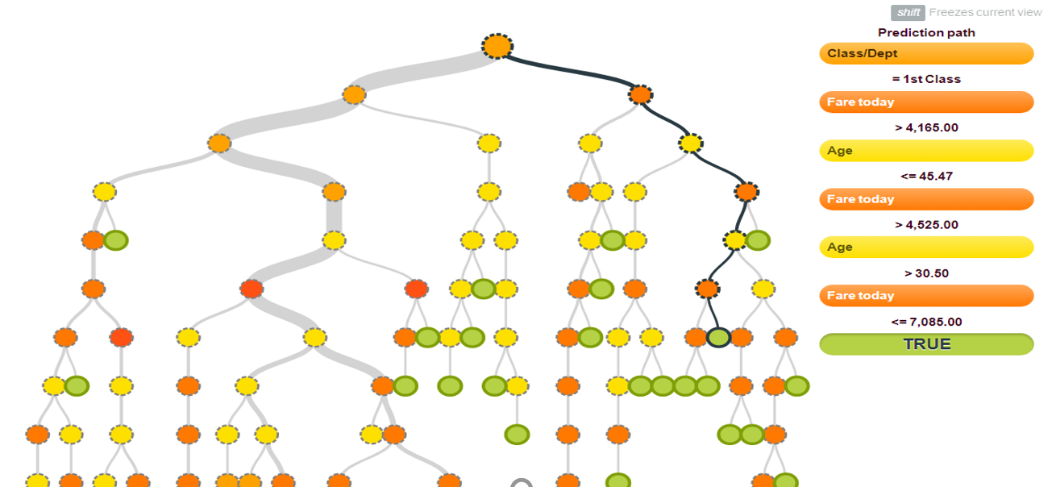
The following is a decision tree created by the bigML cloud application
The visualizations in big data make it easier to analise the problem at hand

Slide 17
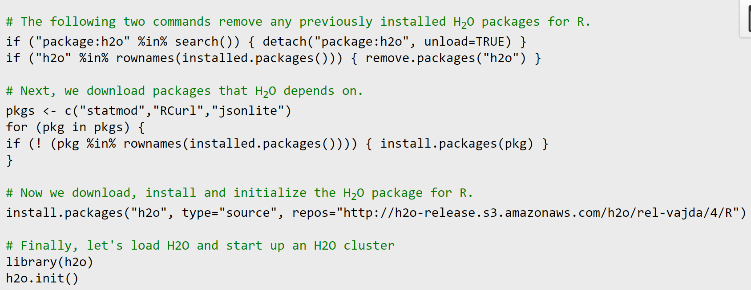
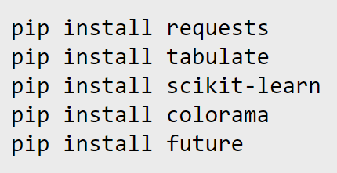

h2o
There are just 2 easy steps to follow for this application :
First install all the libraries in your system and
Second write a code in the iPython notebook or R studio or java to run the different algorithms that you wish to run
The following are the codes for installation in R and python

Slide 18
The codes for Hadoop nd the download s and codes for java are on the website h2o.ai
The iPython notebook code runs the server and checks connectivity and executes all the algorithms required.

Slide 19
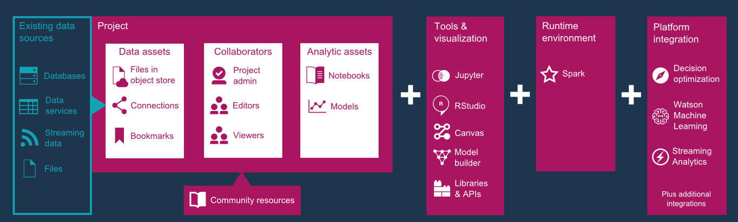
IBM Watson
Architecture

Slide 20
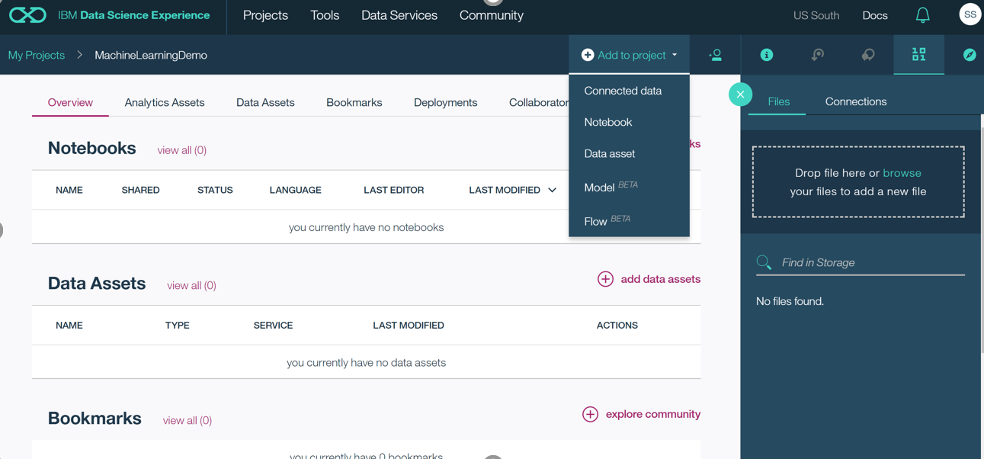
Data Prepration
The data can be input
by going to the data
assets tab and pulling
a file from the local
system

Slide 21
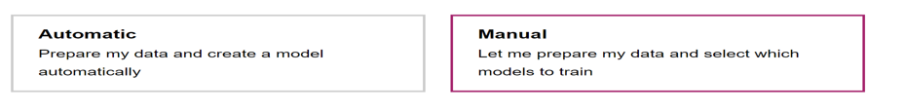
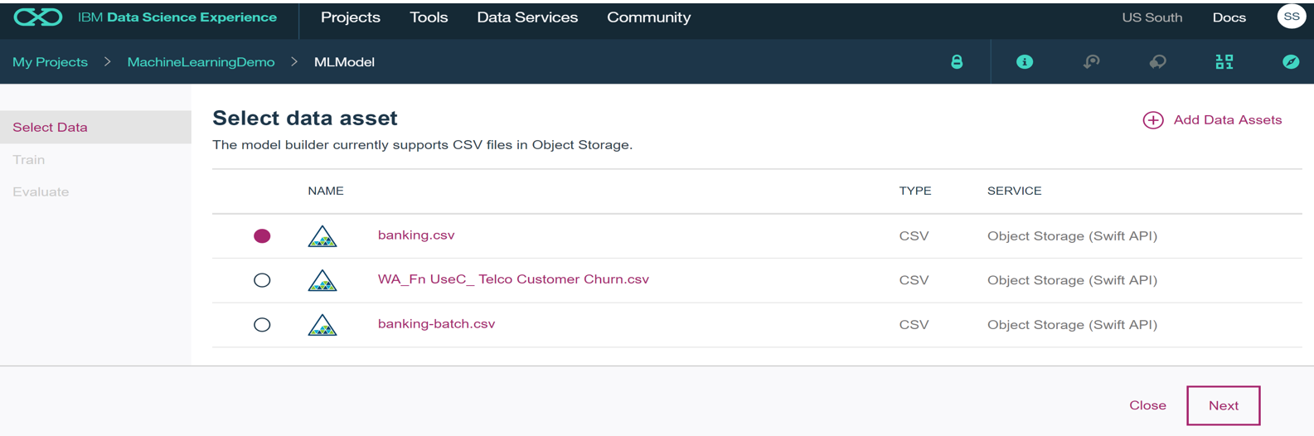
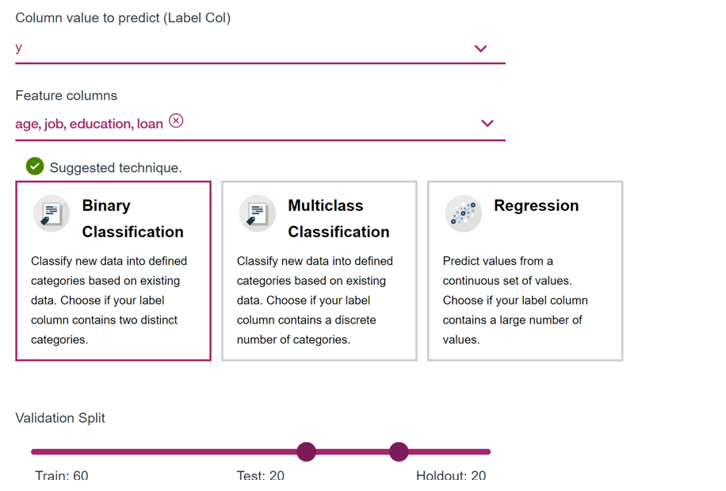
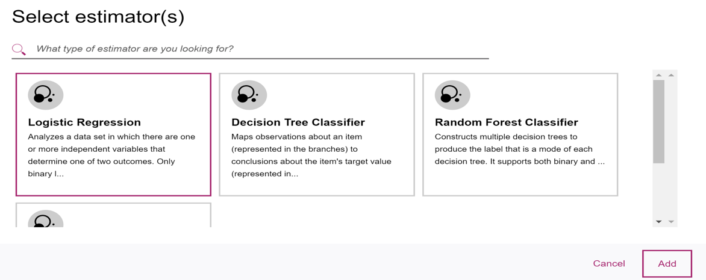
To create a model you need
to select the type of regression
and classification you want to
operate with on the data

Slide 22
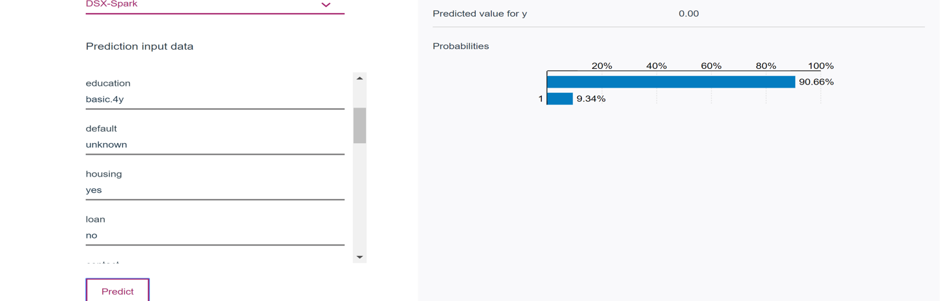
The Prediction looks as below:
We fill in the data manually and the output comes as a probability and score label

Slide 23
Advantages
Advantages of Amazon ML :
User Friendly and easy to understand flow.
Good and interactive UI
Quick Modeling
Provides Evaluation Result
Selects the algorithm based on the Target Data
Customizable

Slide 24
Advantages
Advantages of h2o :
Works on IPython Notebook.
Quick Modeling

Slide 25
Advantages
Advantages of IBM Watson:
Good and interactive UI
Quick Modeling
Selects the algorithm based on the Target Data
Can use R and IPython Scripts and notebooks
Customize Algorithm and data column selection possible

Slide 26
Advantages
Advantages of Azure:
User Friendly and easy to understand flow.
Good and interactive UI
Quick Modeling
Can use R and IPython Scripts and notebooks
Customized Algorithms can be used

Slide 27
Advantages
Advantages of BigML:
User Friendly and easy to understand flow.
Good and interactive UI
Quick Modeling
Easy Visualization of data

Slide 28
Questions ???

Slide 29
Thank you !!!

